Slide 1
EDA Case Study
Nivedita Kapil

Slide 2
Problem statement
When the company receives a loan application, the company must decide for loan approval based on the applicant’s profile. Two types of risks are associated with the bank’s decision:
If the applicant is likely to repay the loan, then not approving the loan results in a loss of business to the company
If the applicant is not likely to repay the loan, i.e. he/she is likely to default, then approving the loan may lead to a financial loss for the company
The given data contains information about past loan applicants and whether they ‘defaulted’ or not. The aim is to identify patterns which indicate if a person is likely to default, which may be used for taking actions such as denying the loan, reducing the amount of loan, lending (to risky applicants) at a higher interest rate, etc.

Slide 3
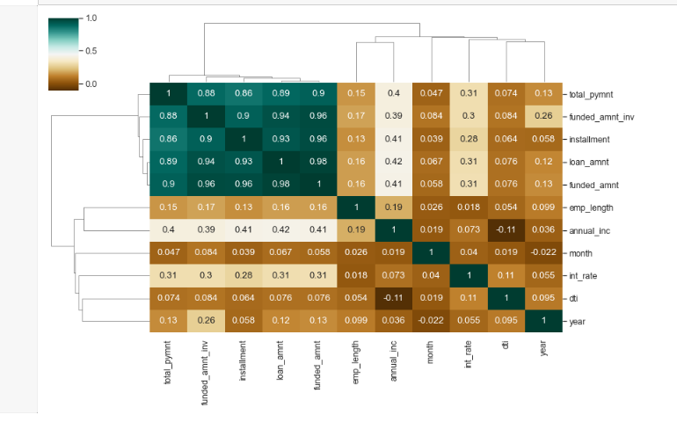
Results- Identify Correlation
Observation is that Loan amount, investor amount, funding amount are strongly correlated.
Annual income with DTI(Debt-to-income ratio) is negatively correlated.
Debt income ratio is the percentage of a consumer's monthly gross income that goes toward paying debts.
That means when annual income is low DTI is high & vice versa.
positive correlation between annual income and employment years.
That means income increases with work experience

Slide 4
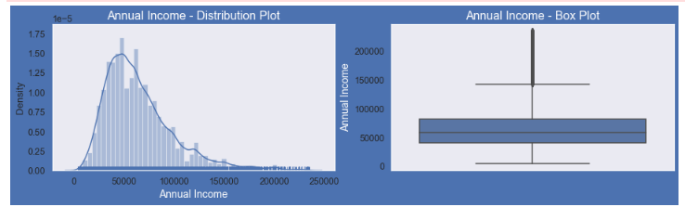
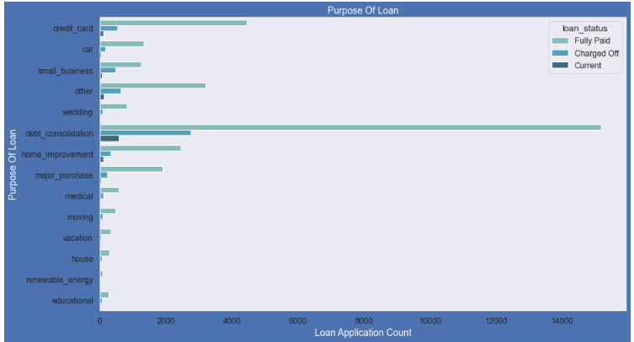
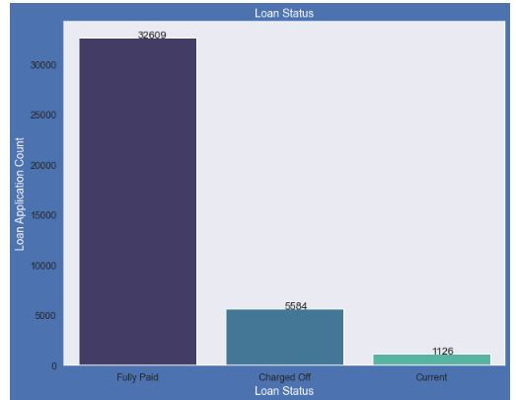
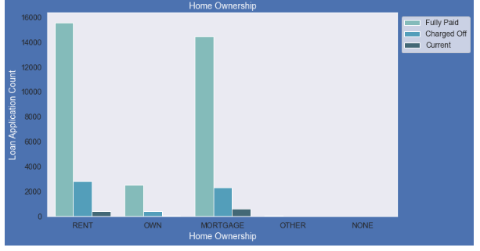
Results
plots show that most of the borrower's Annual incomes are in range of 40000- 80000
plot shows that most of the loans were taken for the purpose of debt consolidation & paying credit card bill.
# Number of charged off count also high too for these loans.
Below plot shows that close to 14% loans were charged off out of total loan issued.
plot shows that most of them living in rented home or mortgaged their home.
Applicant numbers are high from these categories so charged off is high too.

Slide 5
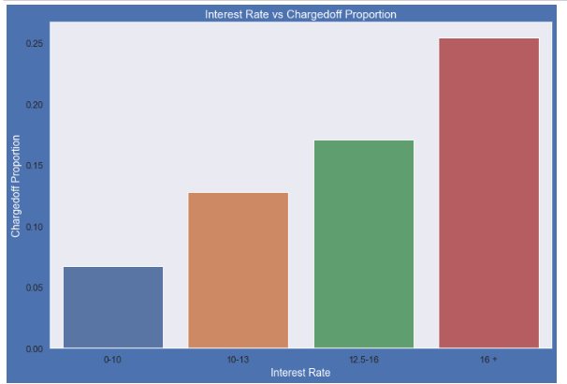
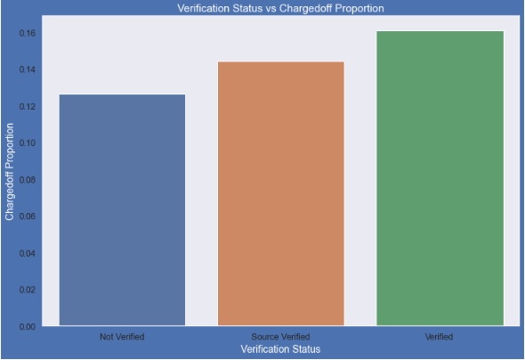
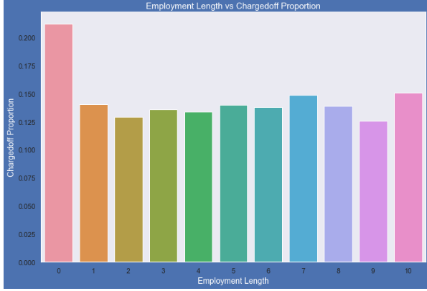
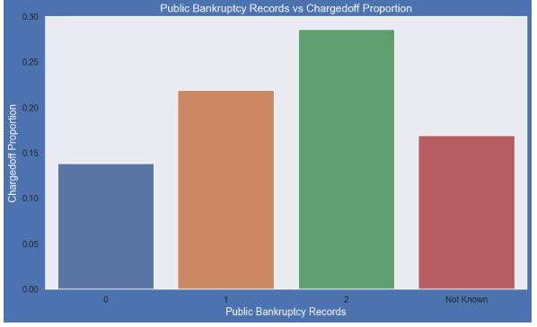
Results
Interest rate less than 10% has very less chances of charged off. Interest rates are starting from minimum 5 %.
Verification status has no impact on charge off
Those who already have pub_rec_bankruptcies value 1, have charged off proportion higher than who have no pub_rec_bankruptcies
Those who are not working or have less than 1 year of work experience have high chances of getting charged off.

Slide 6
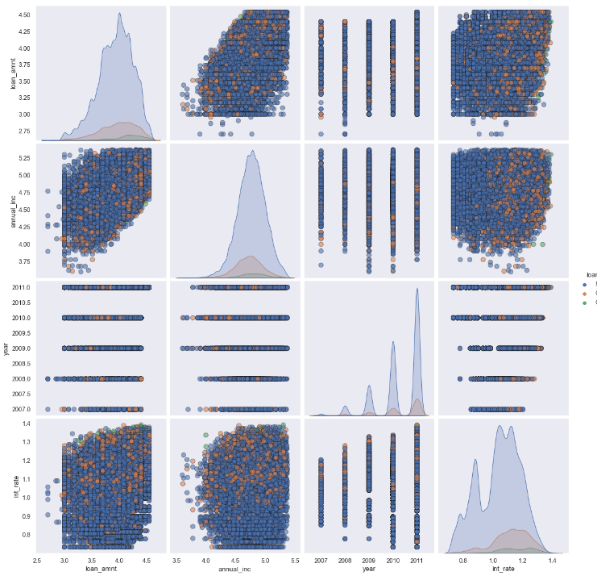
Results
Observation:
Higher the interest rate higher charged off ratio
Higher the annual income higher the loan amount slightly.
Increase in number of charged off with increase in year.
Interest rate is increasing with loan amount increase

